Slide 1

Next-Gen Order Craft
Management System
Presented by :
Squad 3

Slide 2
Project Squad Members
Nandini Gupta
Prashant Kumar Singh
Nisheet Saxena
Prachi Chauhan
Harshit Shastri
Srajan Sharma

Slide 3
Abstract
Order-Craft is a secure, scalable supply chain and inventory management platform built with Spring Boot and JWT authentication.
Designed for manufacturing and retail environments, it streamlines procurement, stock control, supplier management, production scheduling, and order tracking.
Provides real-time inventory visibility, automated workflows to reduce manual errors, and customizable dashboards with alerts for low stock.
Integrates modules for order processing, supplier handling, and logistics, ensuring seamless end-to-end operations from intake to delivery.
Equipped with robust reporting and analytics, enabling data-driven decision-making and improving overall supply chain performance.

Slide 4
Purpose of the Project
Transform traditional order and inventory management processes by reducing inefficiencies and minimizing manual intervention.
Provide personalized dashboards, role-based access, and real-time tracking to empower stakeholders.
Improve stock optimization to avoid shortages and overstocking with proactive alerts and automated workflows.
Foster collaboration, transparency, and accountability across the entire supply chain.
Ensure timely order fulfillment, customer satisfaction, and operational efficiency.
Deliver a future-ready solution adaptable to complex, multi-warehouse operations of any scale.

Slide 5
Existing vs Proposed System
Advantages of Proposed System:
Real-time inventory and order tracking.
AI-driven demand forecasting.
Integration with third-party logistics.
Role-based dashboards and automated alerts.
Centralized reporting and analytics
Disadvantages of Existing System:
The current system’s drawbacks include labor-intensive procedures that are prone to mistakes and delays.
Unable to view data in real time.
Inadequate logistics and supplier integration.
Limited capacity for forecasting and reporting.

Slide 6
Technology Stack
Frontend Technologies:
Angular
HTML/CSS
Bootstrap
Backend Technologies:
Java (Spring Boot)
REST APIs
Oracle SQL
JWT Authentication

Slide 7
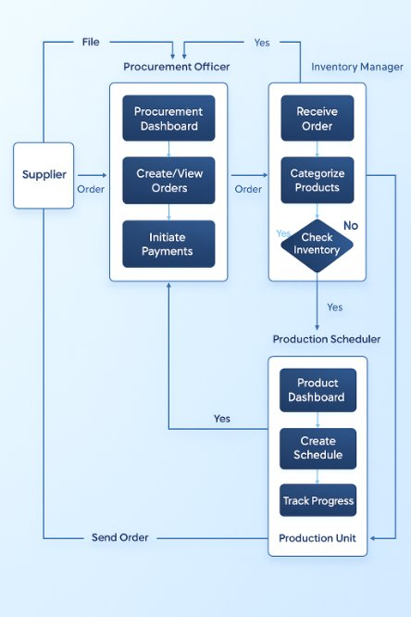
Application Flow Diagram

Slide 8
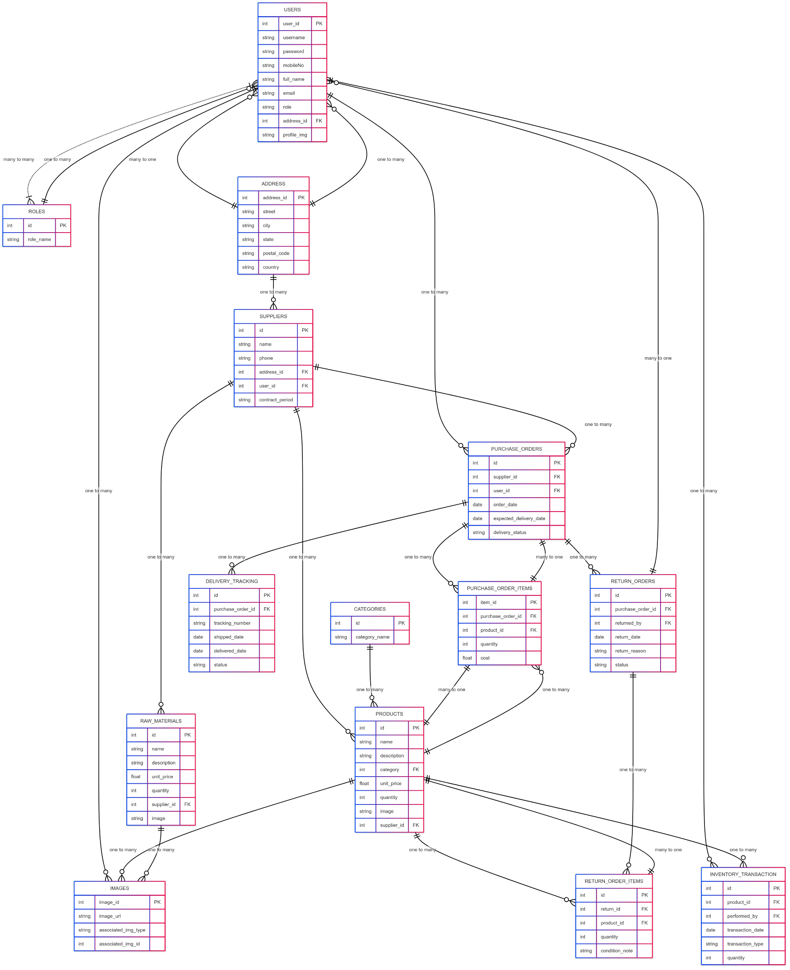
Database Flow Diagram

Slide 9
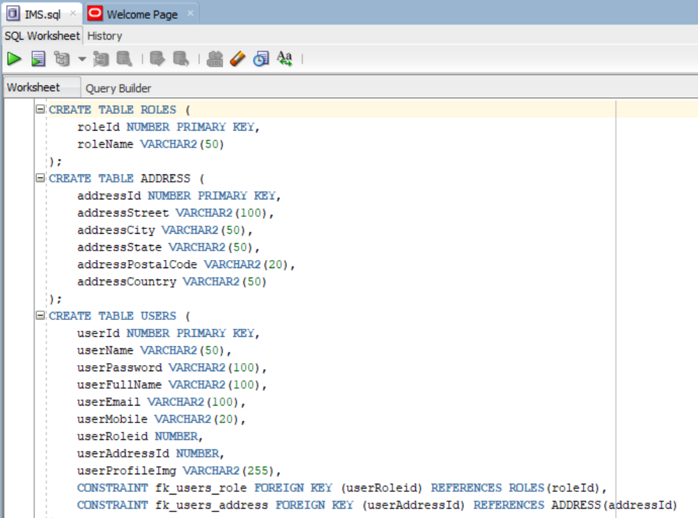
Database

Slide 10
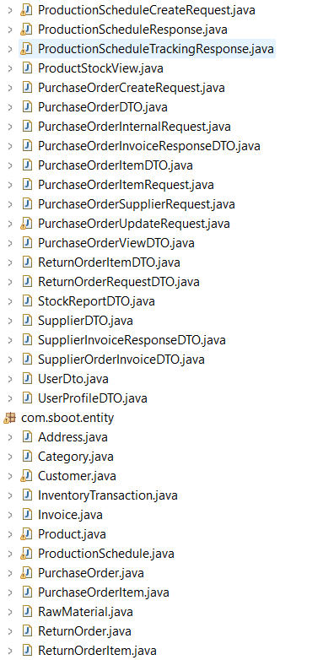
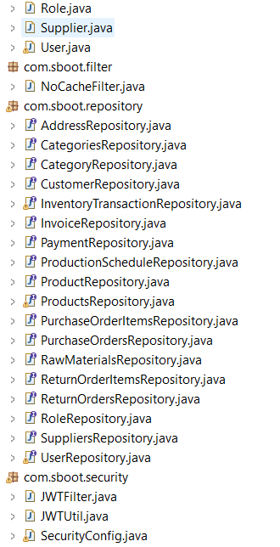
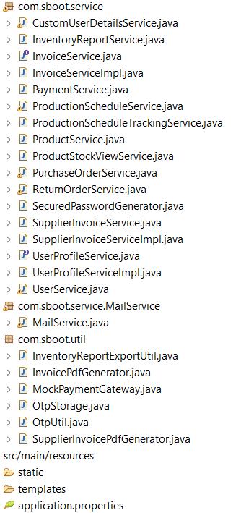
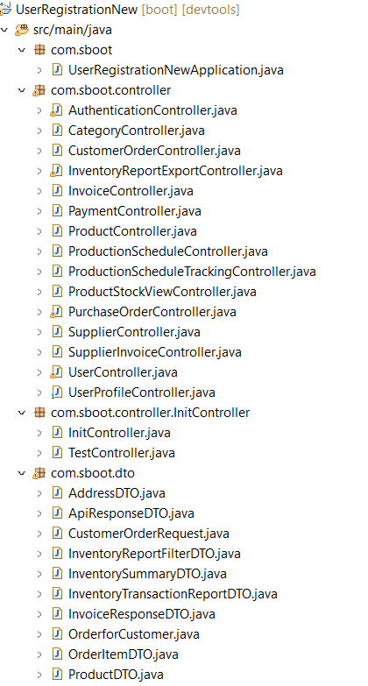
Backend Structure

Slide 11
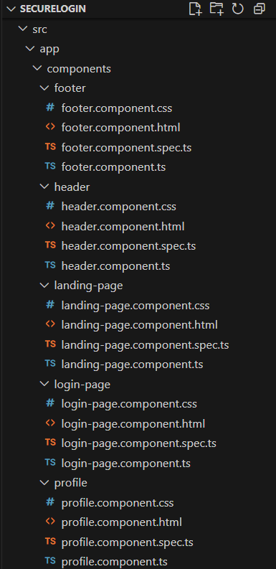
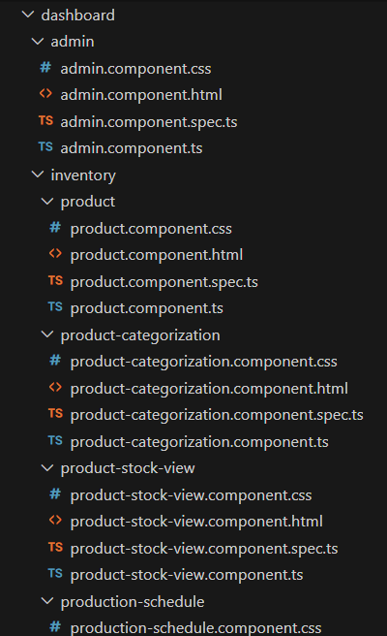
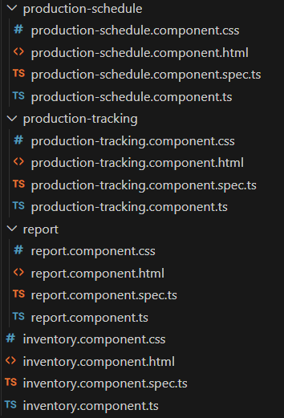
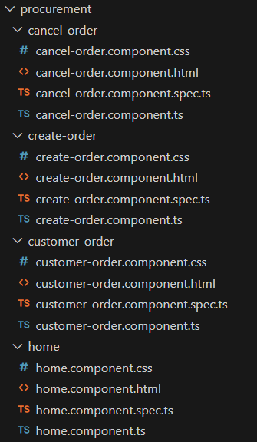
Frontend Structure

Slide 12
Epic 1: User Registration
This epic covers the secure onboarding of users, login mechanisms, password policies, session management, and account status controls. It ensures that users are authenticated reliably and have controlled access to the inventory platform.
User Stories:
User Registration
Secure Login
Password Reset
Password Policy Enforcement
Account Lockout
Session Timeout
User Profile Update

Slide 13
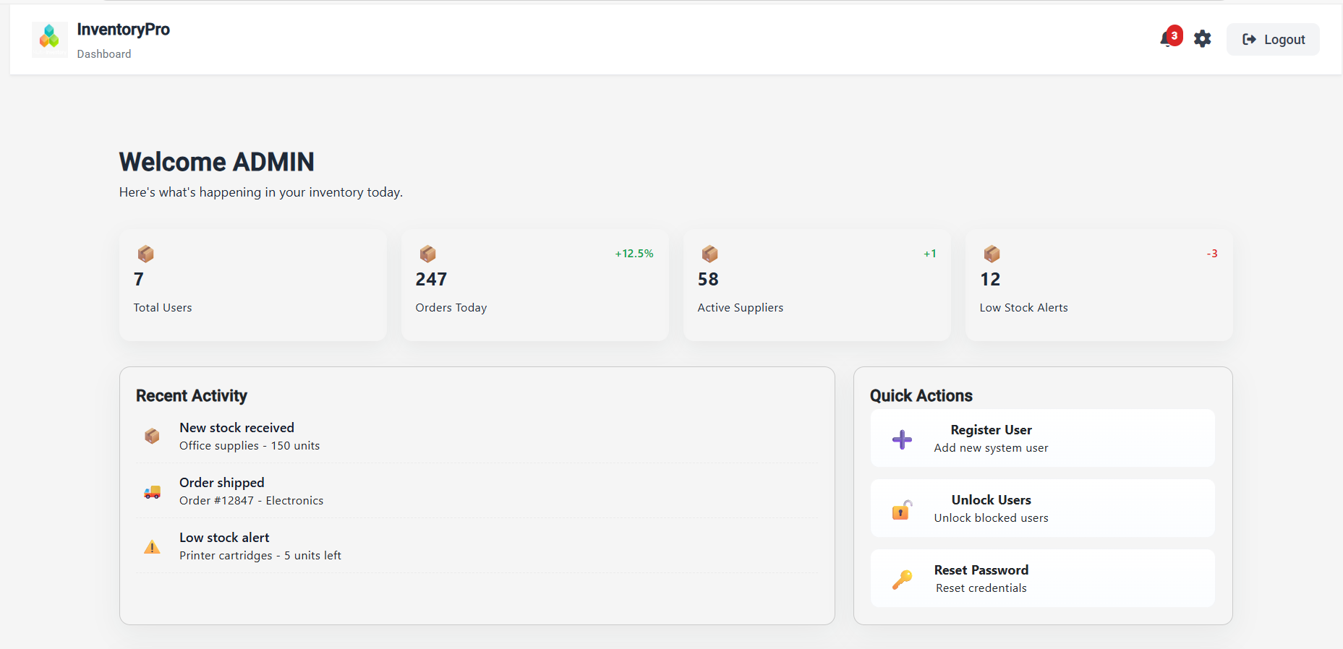
Admin Dashboard

Slide 14
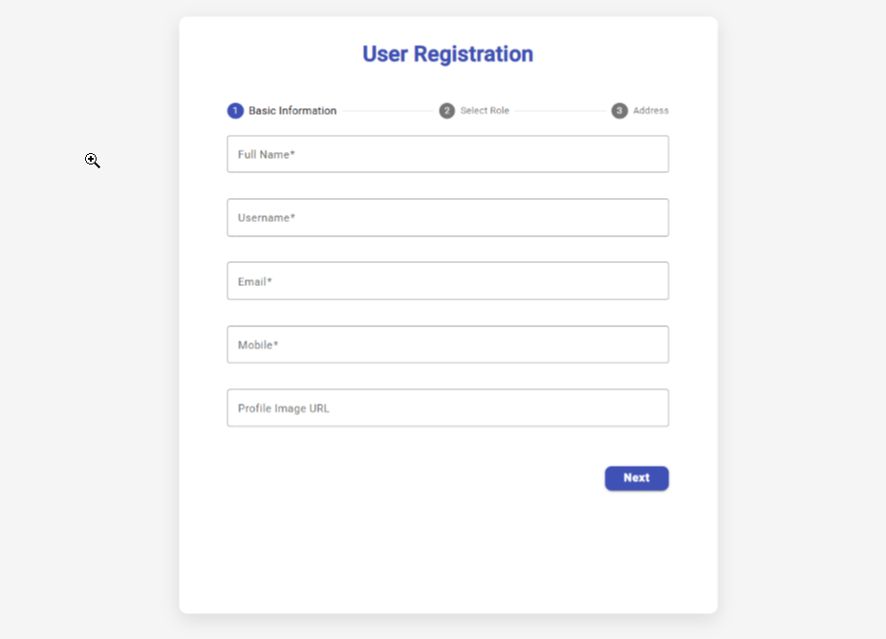
User Registration

Slide 15
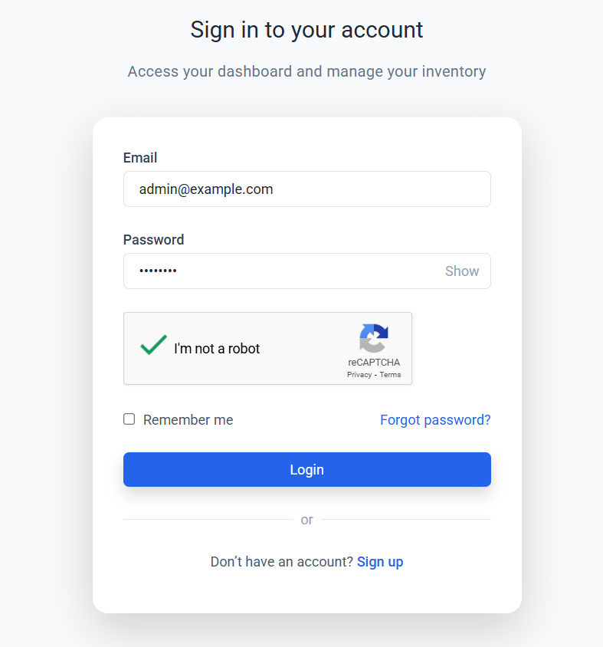
Login Page

Slide 16
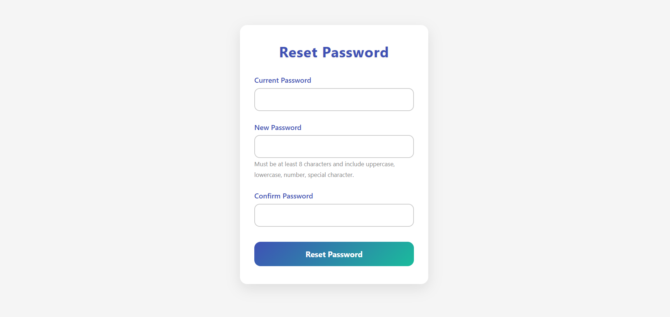
Reset Password

Slide 17
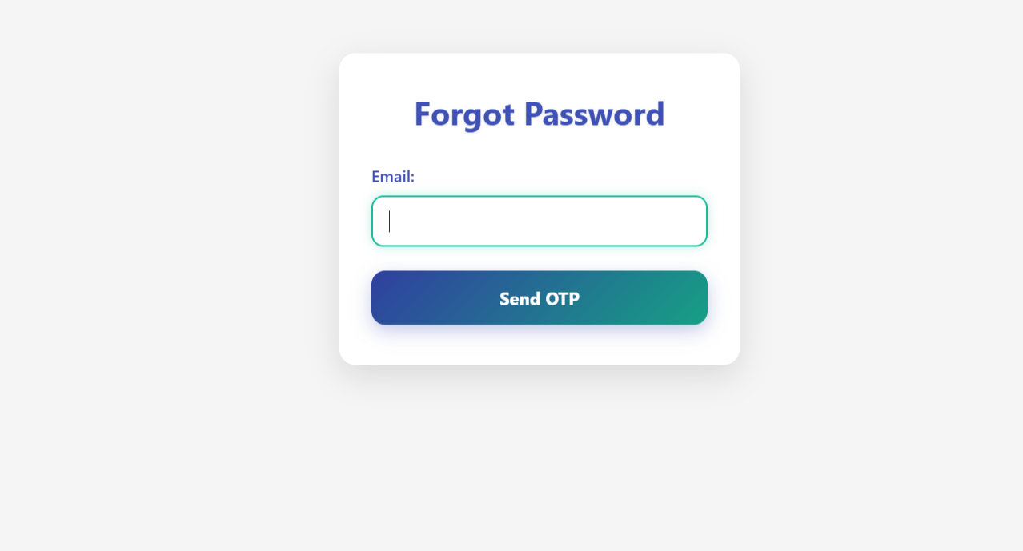
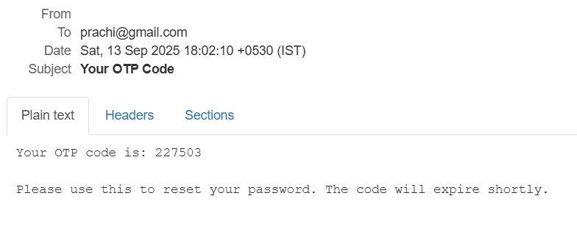
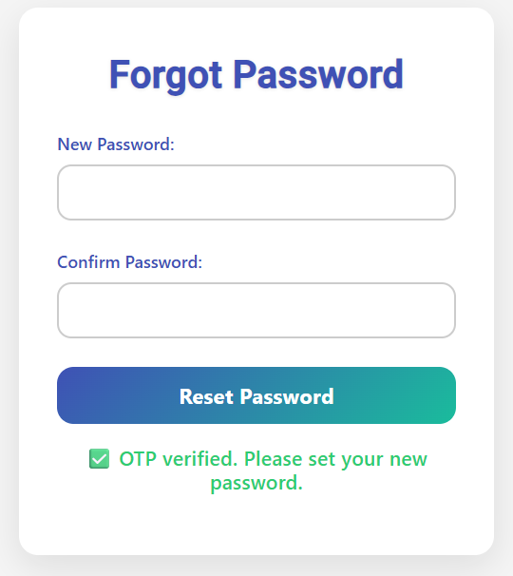
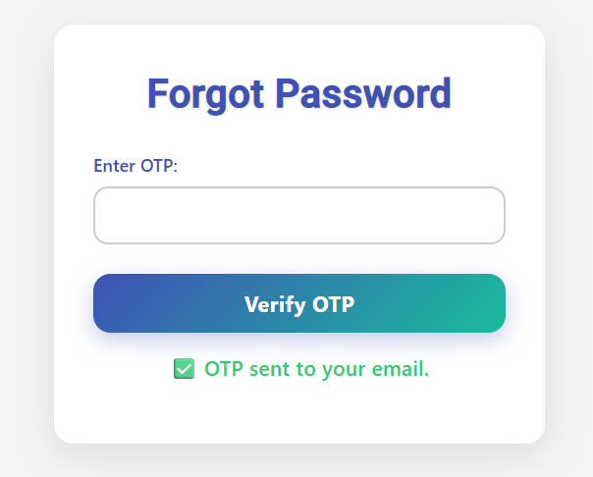
Forgot Password

Slide 18
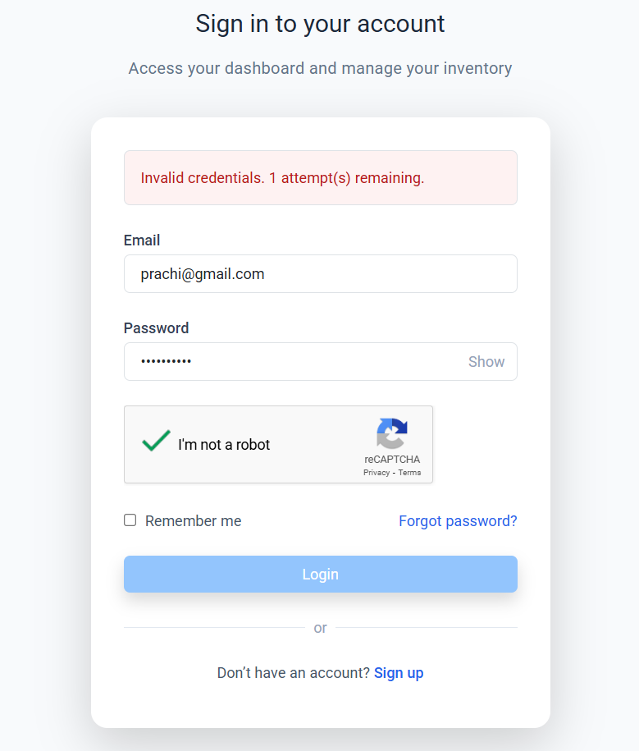
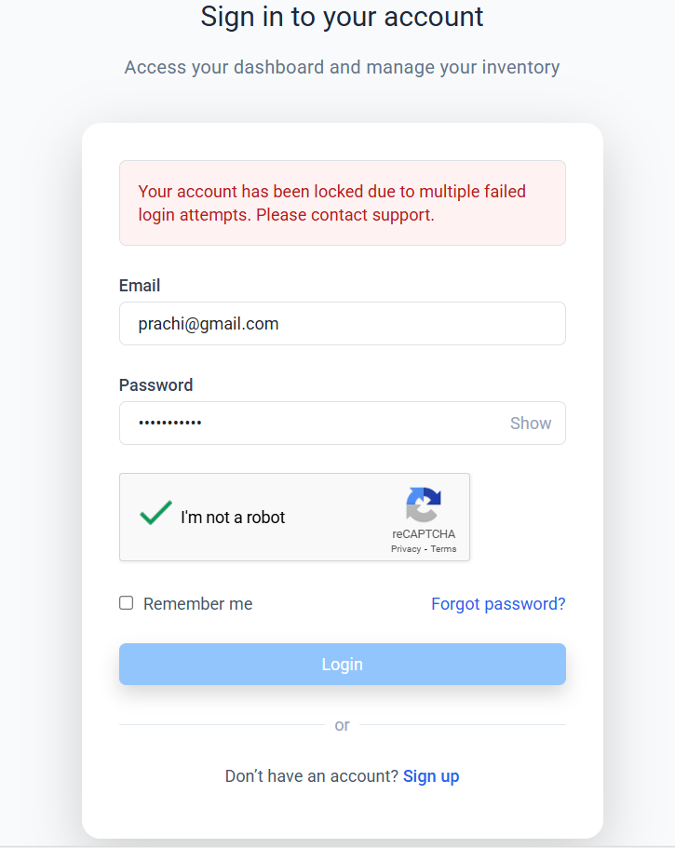
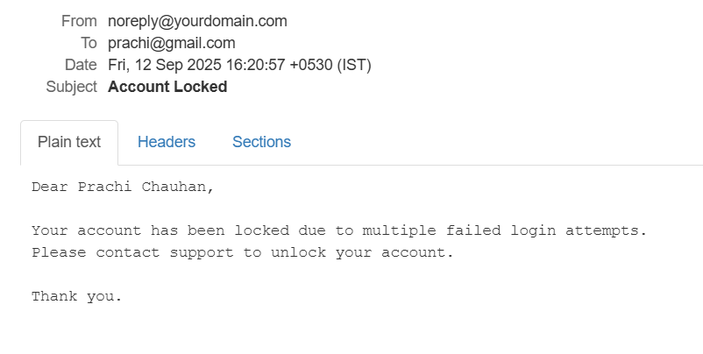
Account Lockout

Slide 19
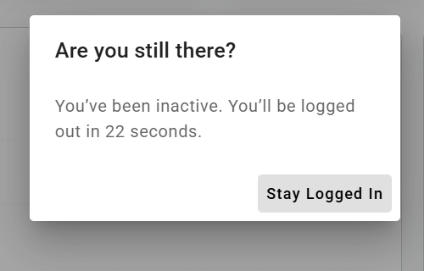
Session Timeout

Slide 20
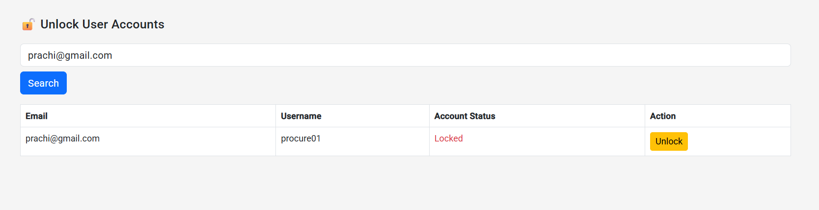
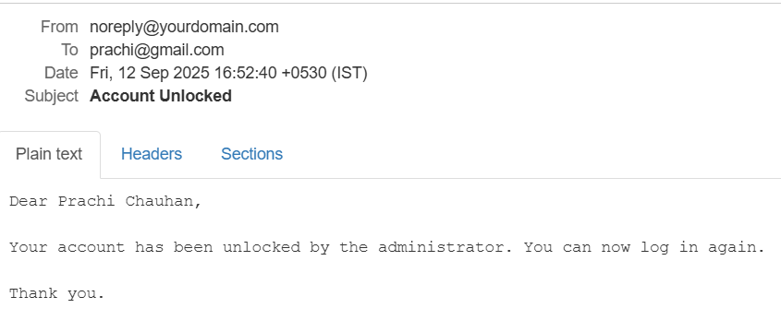
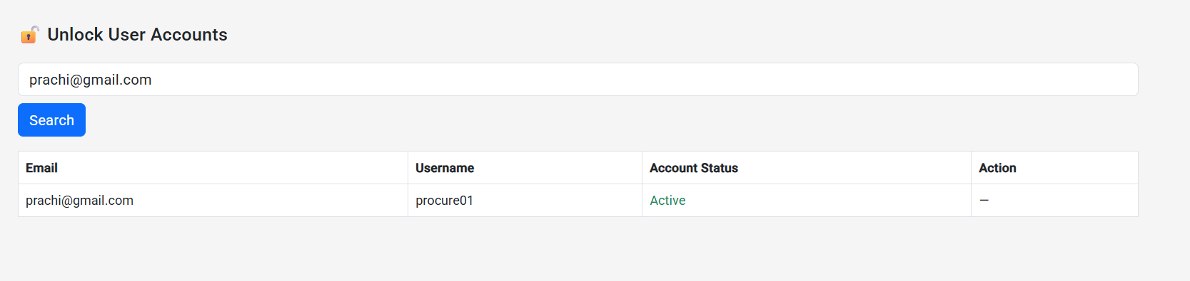
Account Unlock

Slide 21
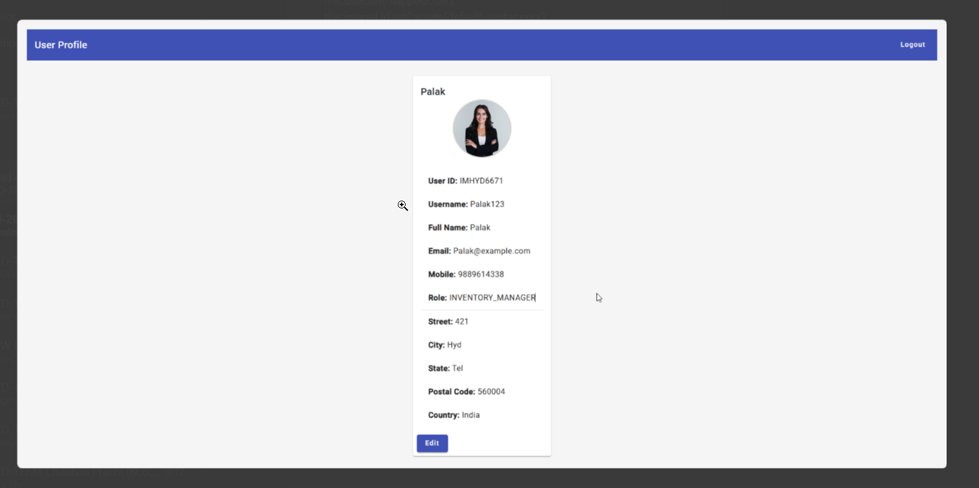
User Profile

Slide 22
Epic 2: Order Creation and Management
This epic covers the end-to-end lifestyle of orders including creation, modification, tracking, cancellation and returning. The goal is to ensure that the entire order flow from creation to fulfillment is seamless and transparent.
User Stories:
Create Order
View Order History
Update Order Details
Track Order Status
Cancel Order
Order Payment Integration
Order Invoice Generation
Return Order

Slide 23
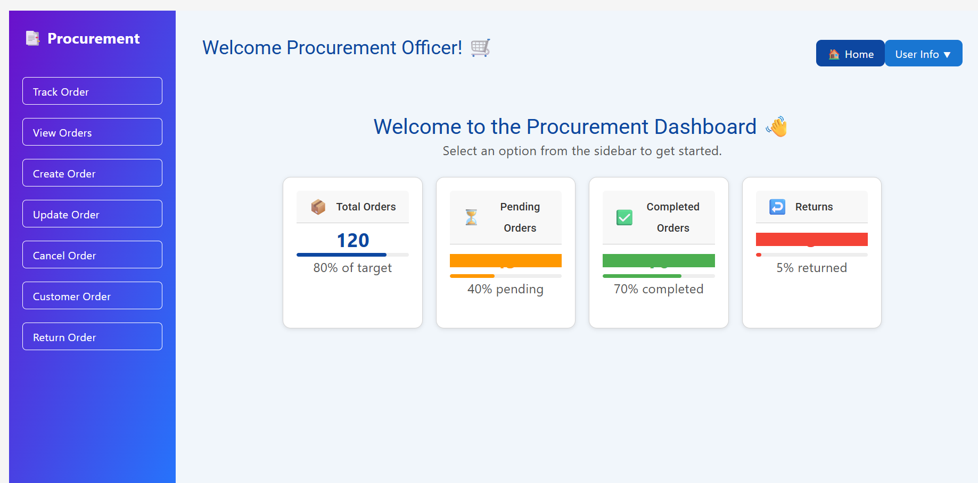
Procurement Officer Dashboard

Slide 24
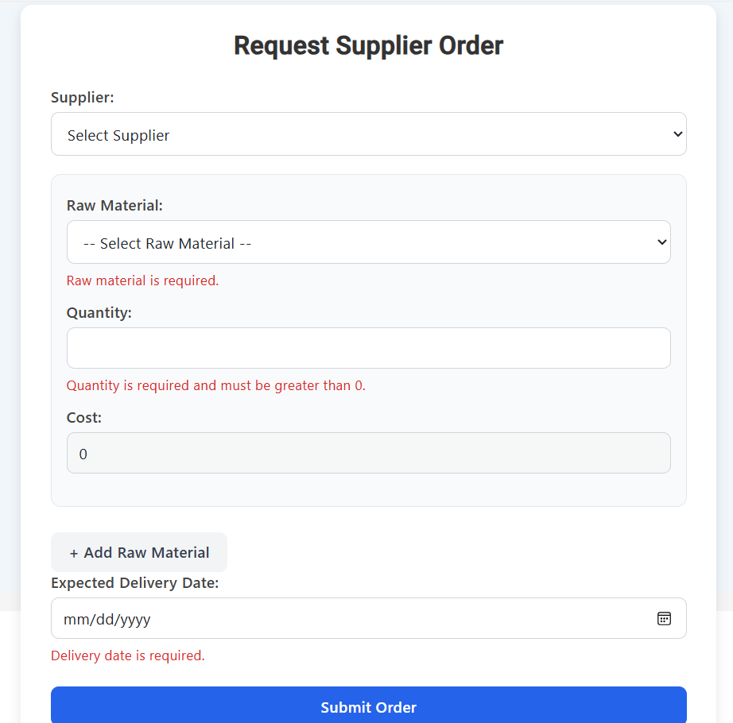
Create Order

Slide 25
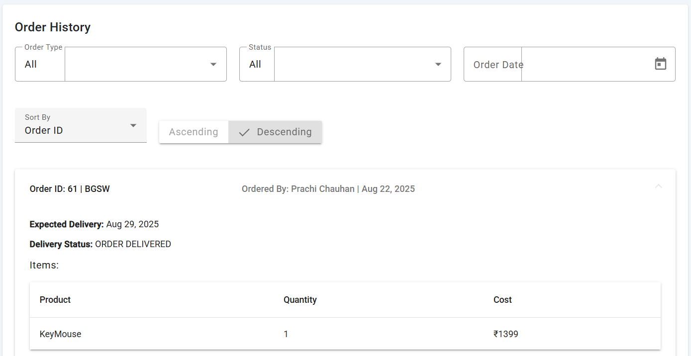
View Order History

Slide 26
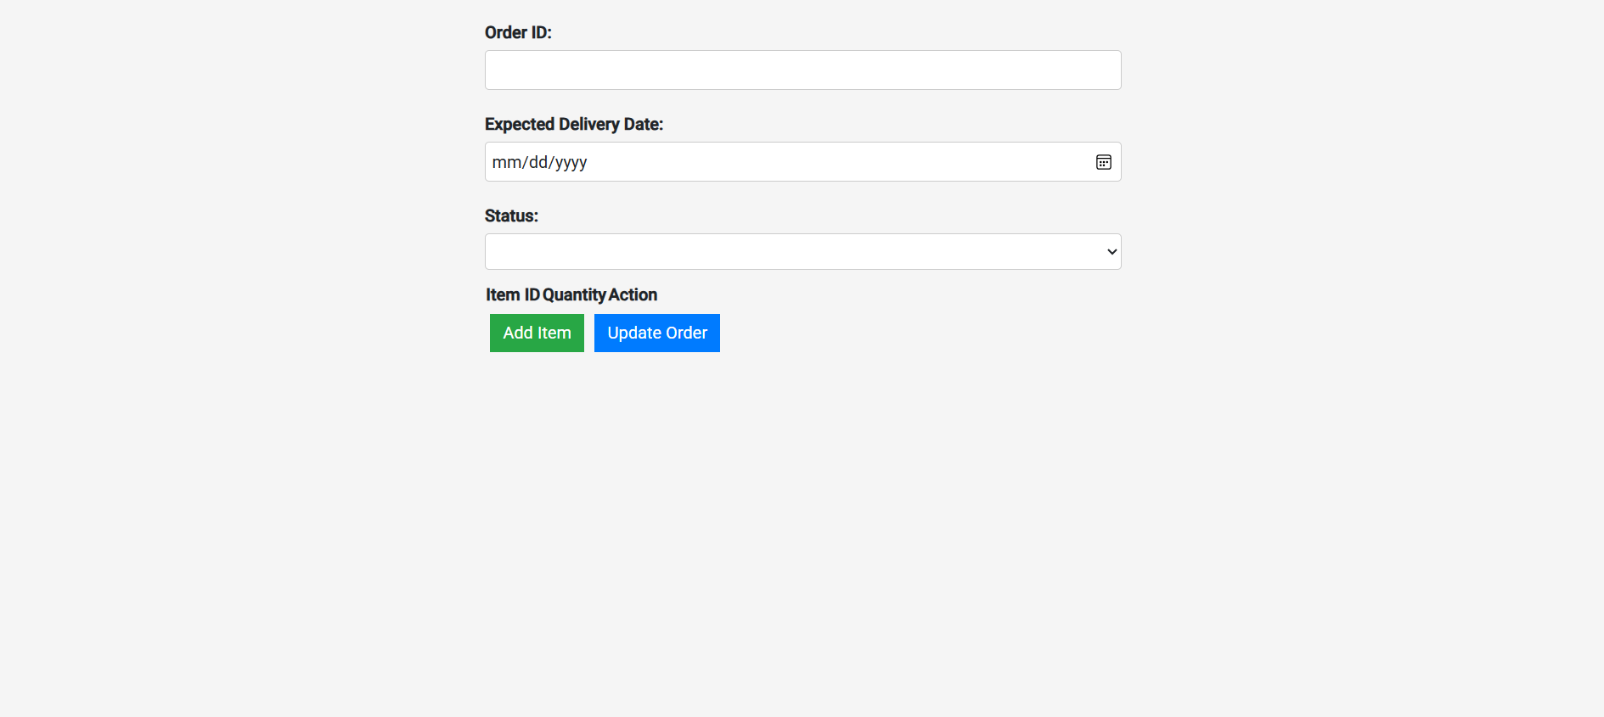
Update Order Details

Slide 27
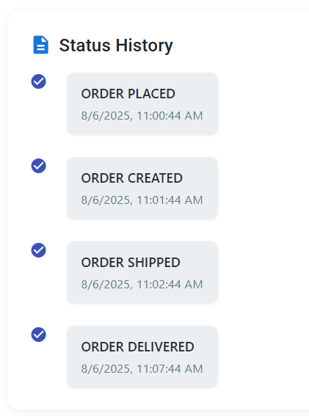
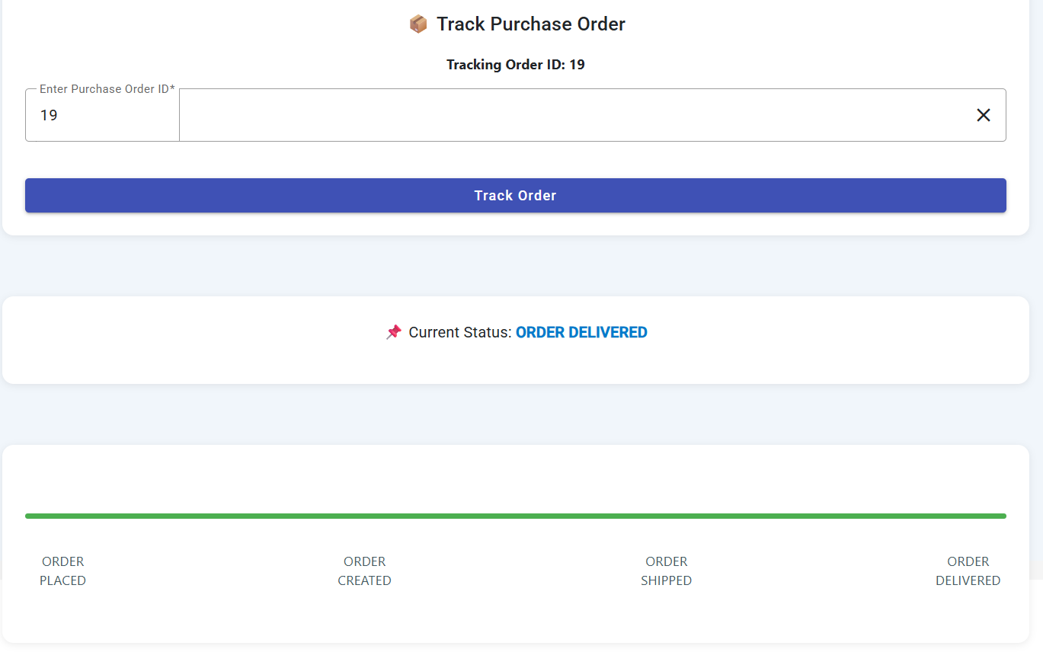
Track Order Status

Slide 28
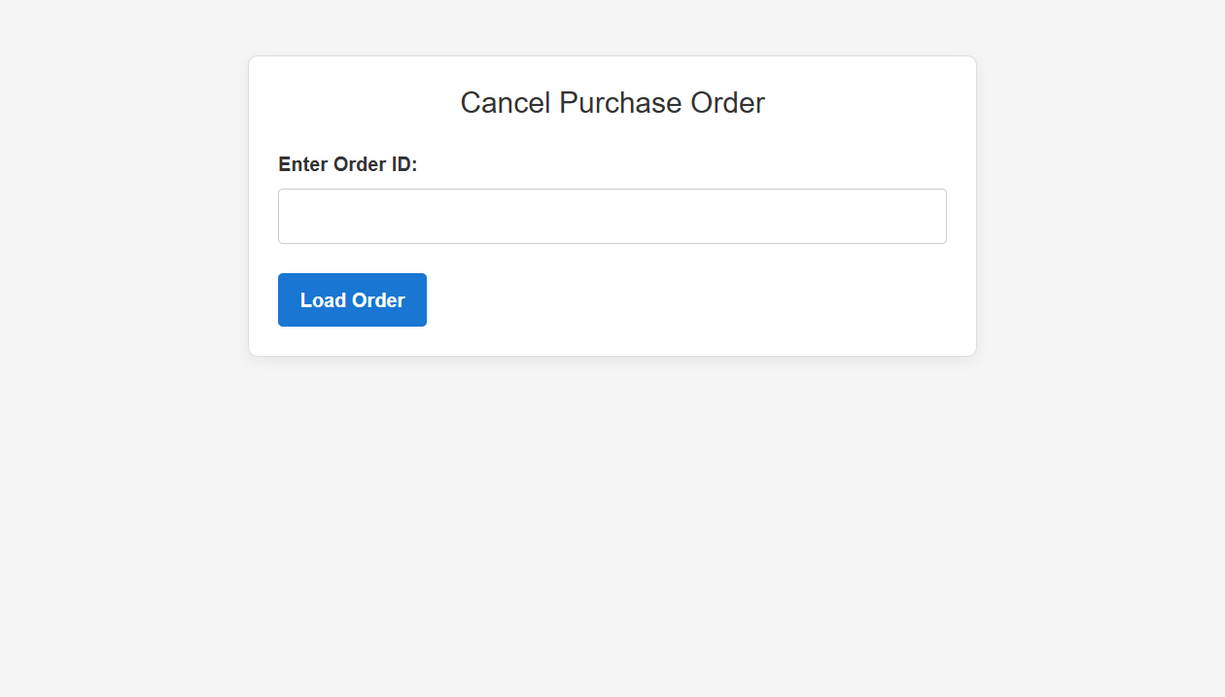
Cancel Order

Slide 29
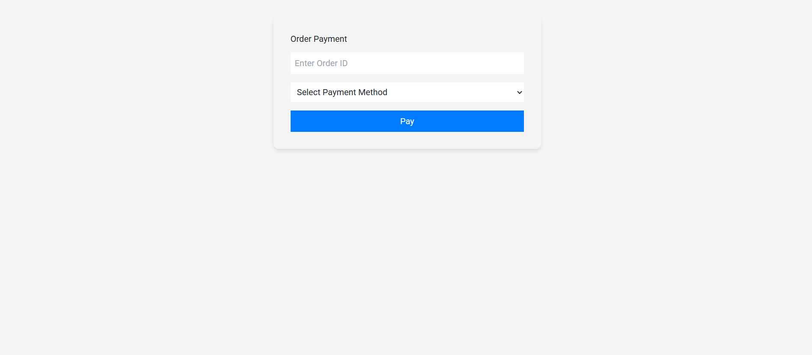
Order Payment Integration

Slide 30
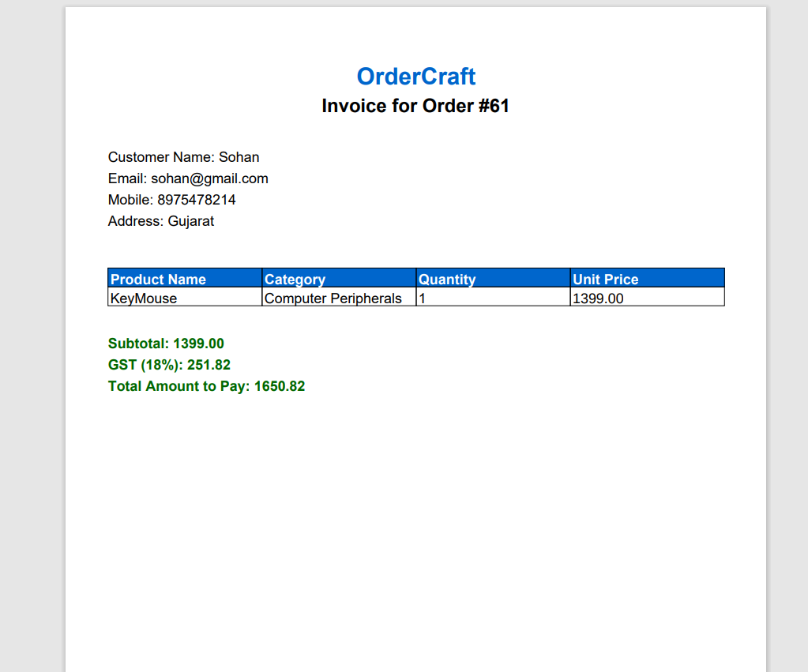
Order Invoice Generation

Slide 31
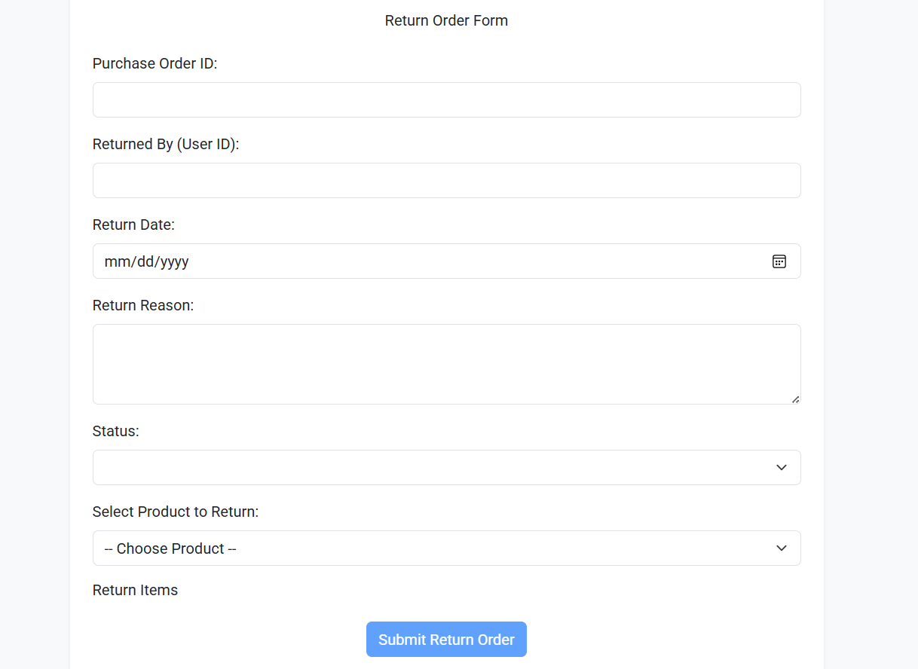
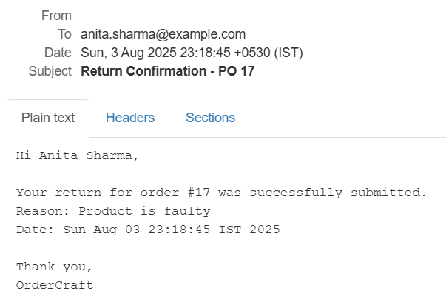
Return Order

Slide 32
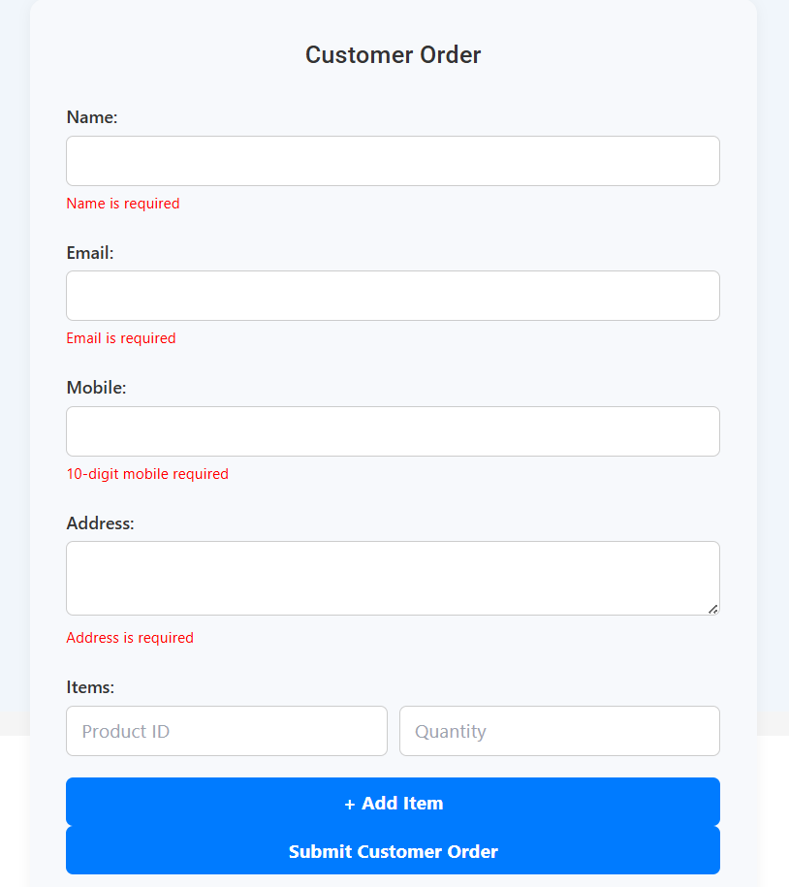
Customer Order

Slide 33
Epic 3: Inventory Tracking and Management
This epic covers the end-to-end lifecycle of inventories including tracking, product categorization, automatic alerts, inventory reports and handling and returning adjustments. The goal is to ensure that the entire inventory flow from creation to fulfillment is seamless and transparent.
User Stories:
Track Inventory Levels
Product Categorization
Automatic Replenishment Alerts
Generate Inventory Reports
Handle Returns and Adjustments

Slide 34
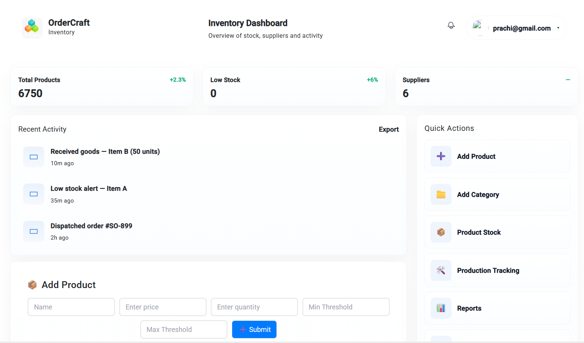
Inventory Dashboard

Slide 35
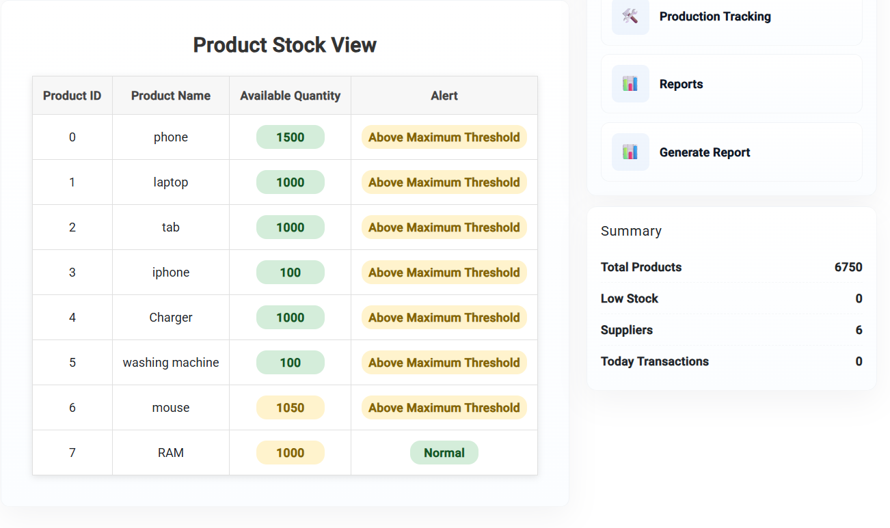
Track Inventory Levels

Slide 36
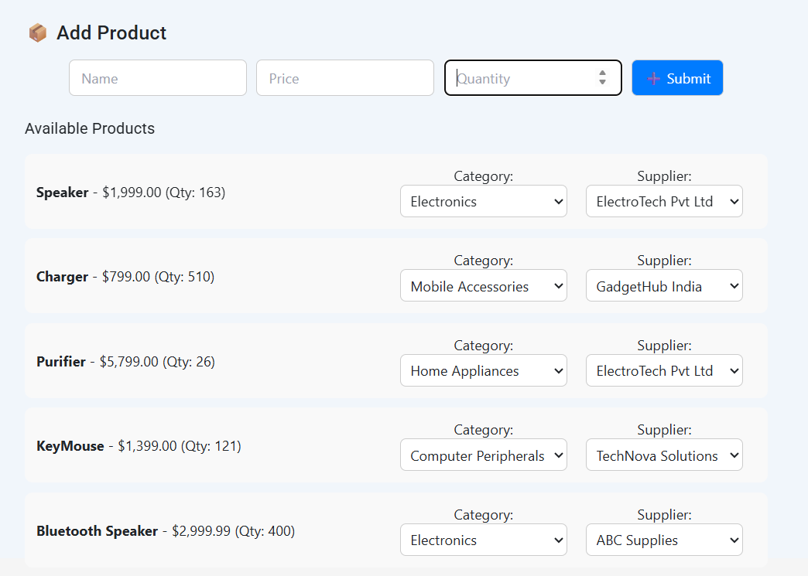
Product Categorization

Slide 37
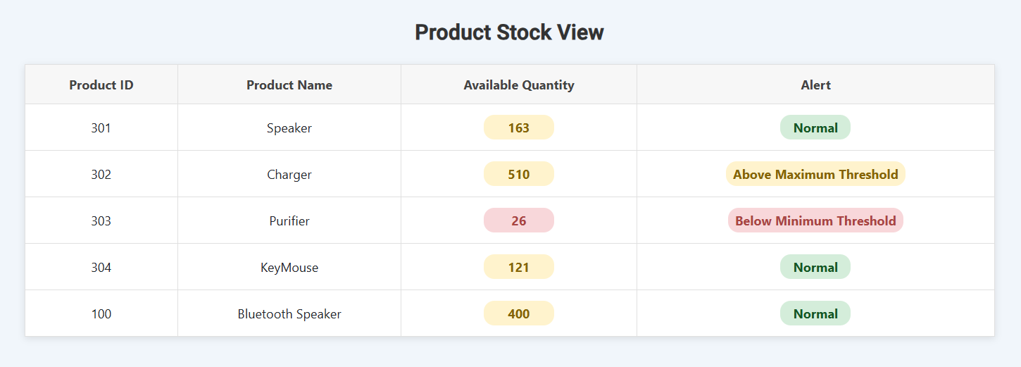
Automatic Replenishment Alerts

Slide 38
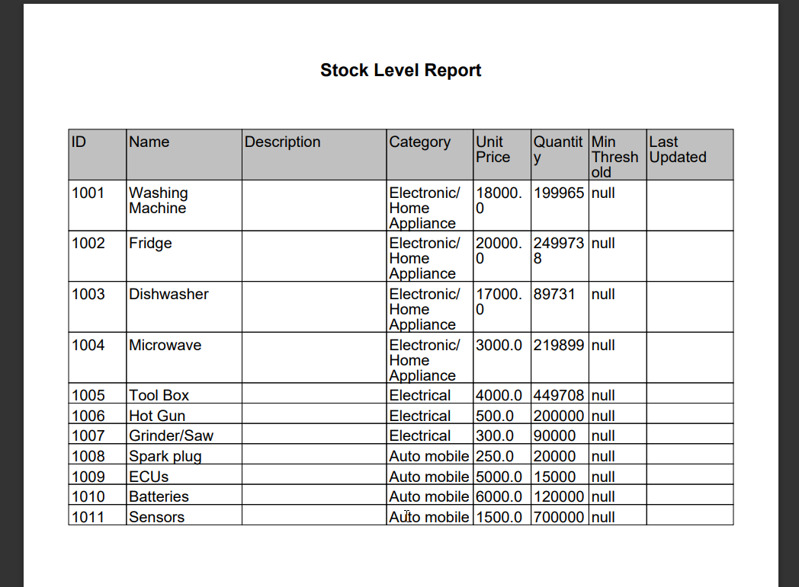
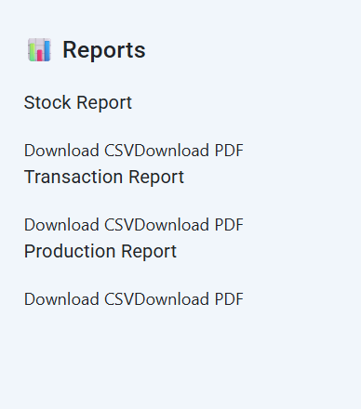
Generate Inventory Reports

Slide 39
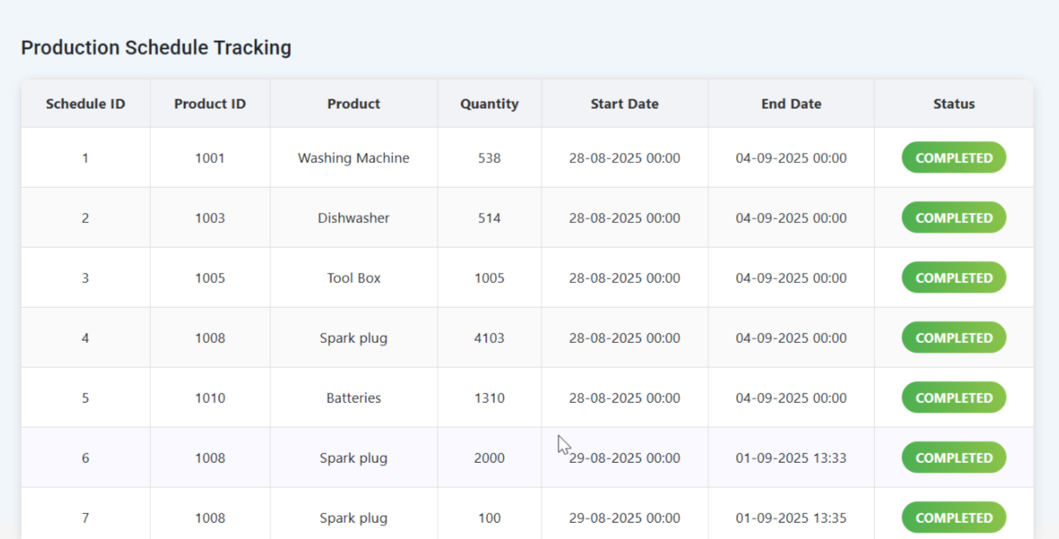
Production Schedule Tracking

Slide 40
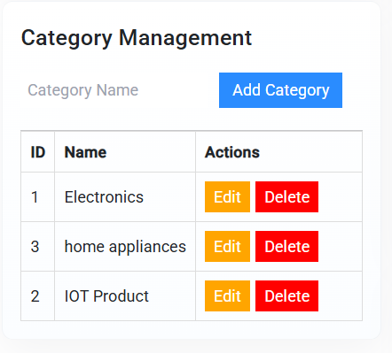
Category Management

Slide 41
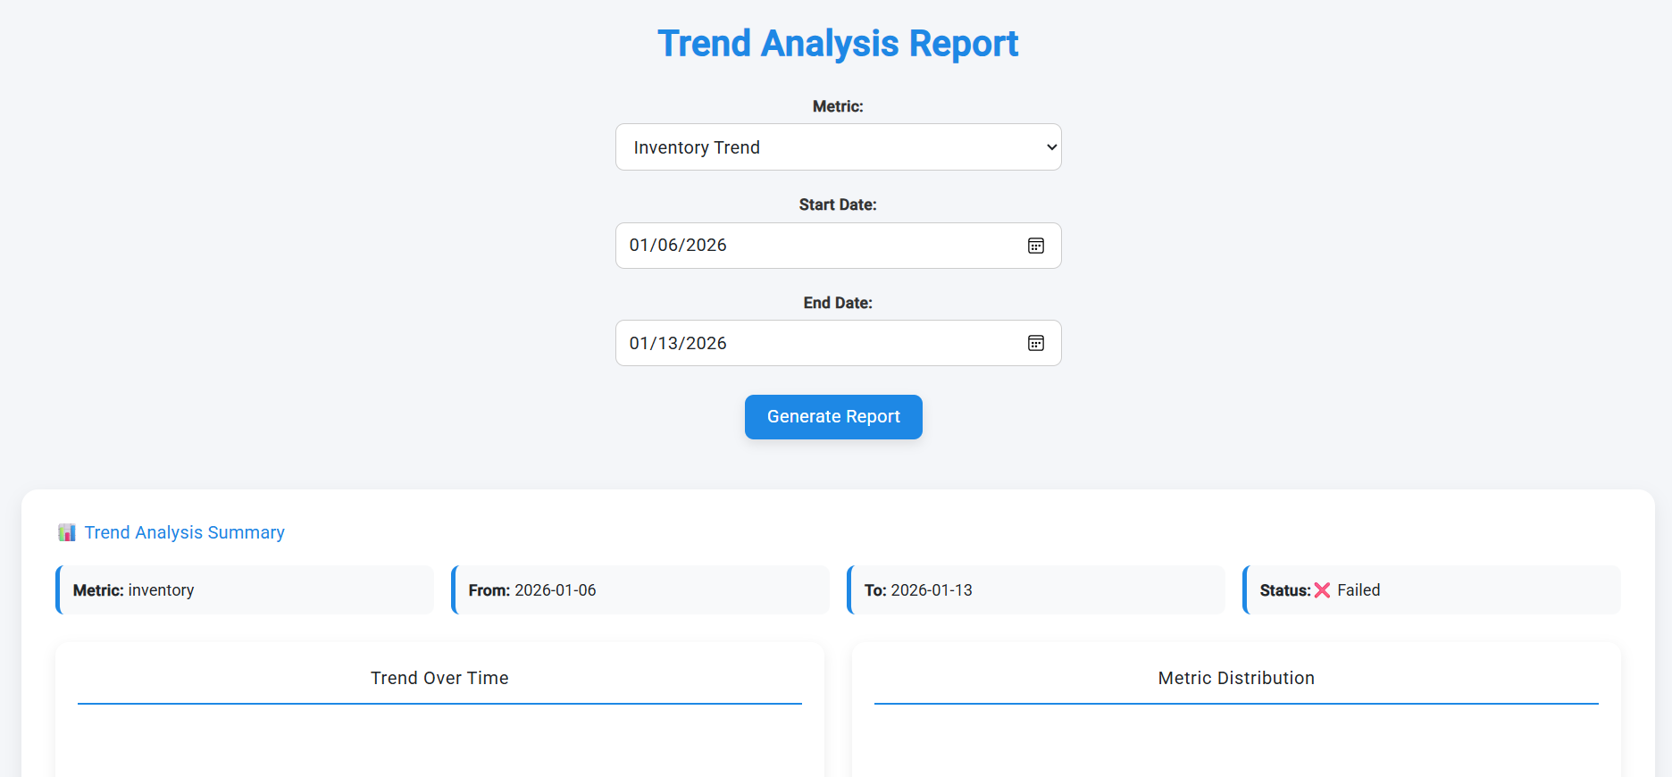
Trend Analysis Report

Slide 42
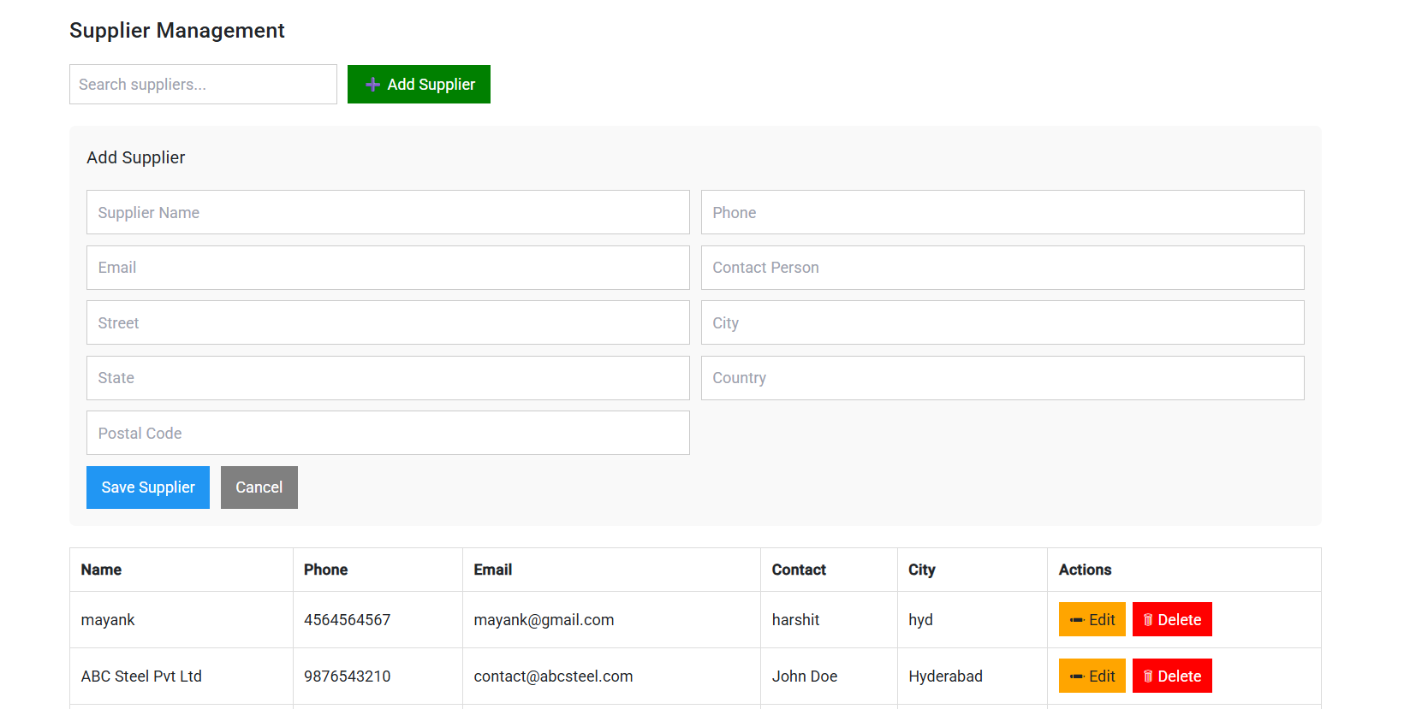
Supplier Management

Slide 43
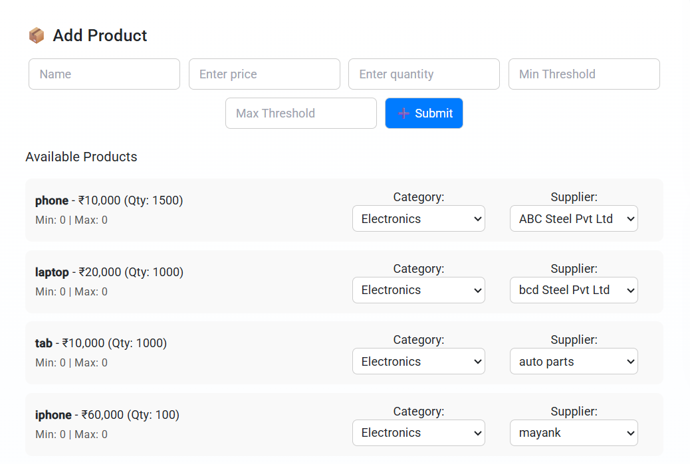
Product Categorization

Slide 44

Payment Integration

Slide 46
THANK YOU

